Slide 1
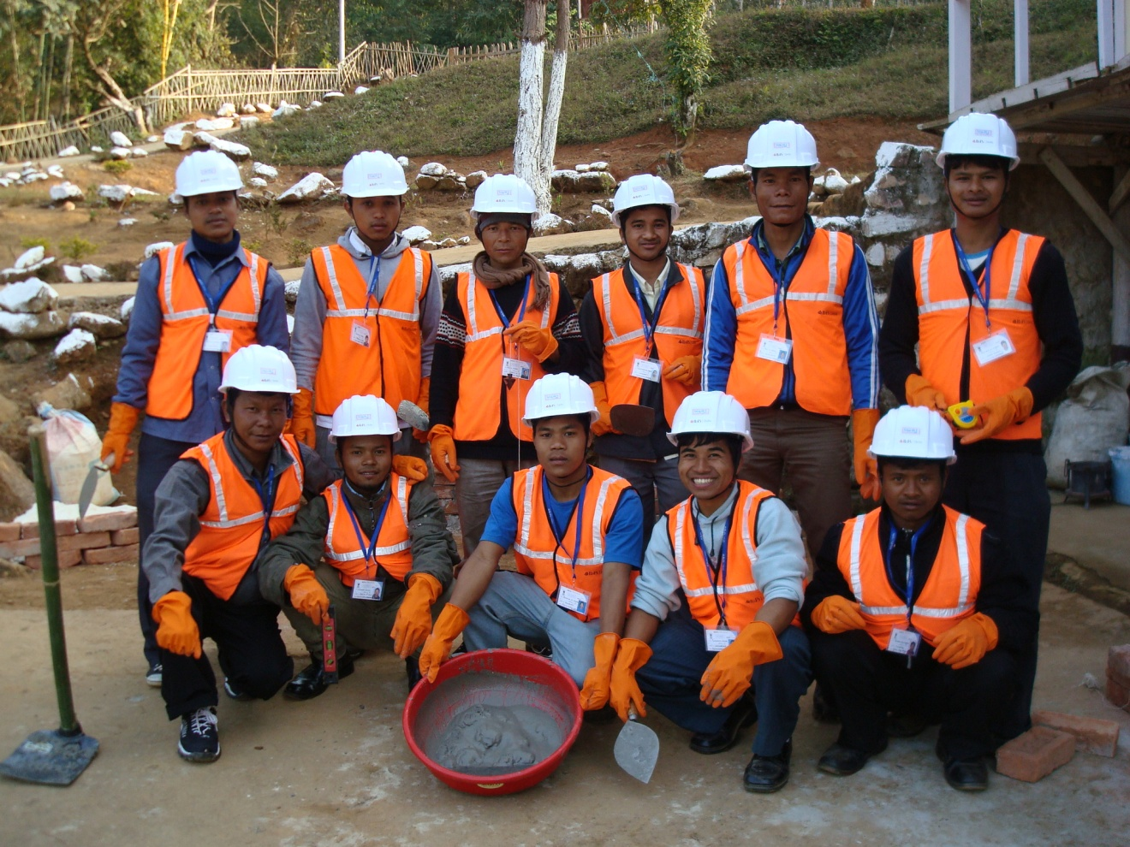
Supporting Human Capital Development in Meghalaya
.
8th May 2015
Rashmi Mehra
TVET Institutional Strengthening Specialist

Slide 2
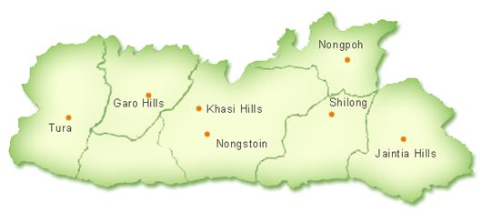
Employment Status at a Glance
Meghalaya – Activity Status of Population as per 2011 census
Total Population | 2966889
Workers | 1185619
Non-workers | 1638517
Unemployed | 142753
Notes:
Long term unemployement

Slide 3
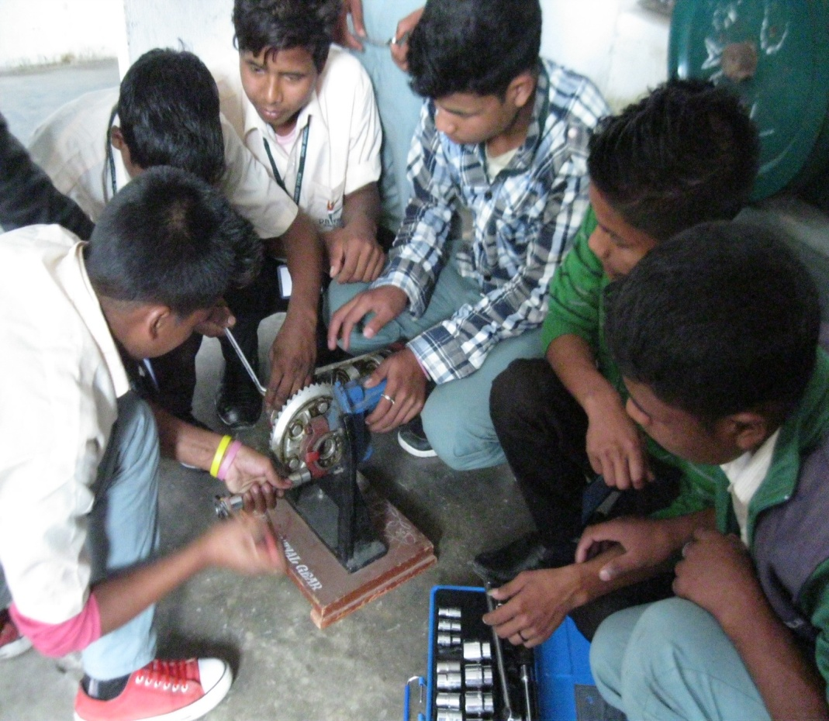
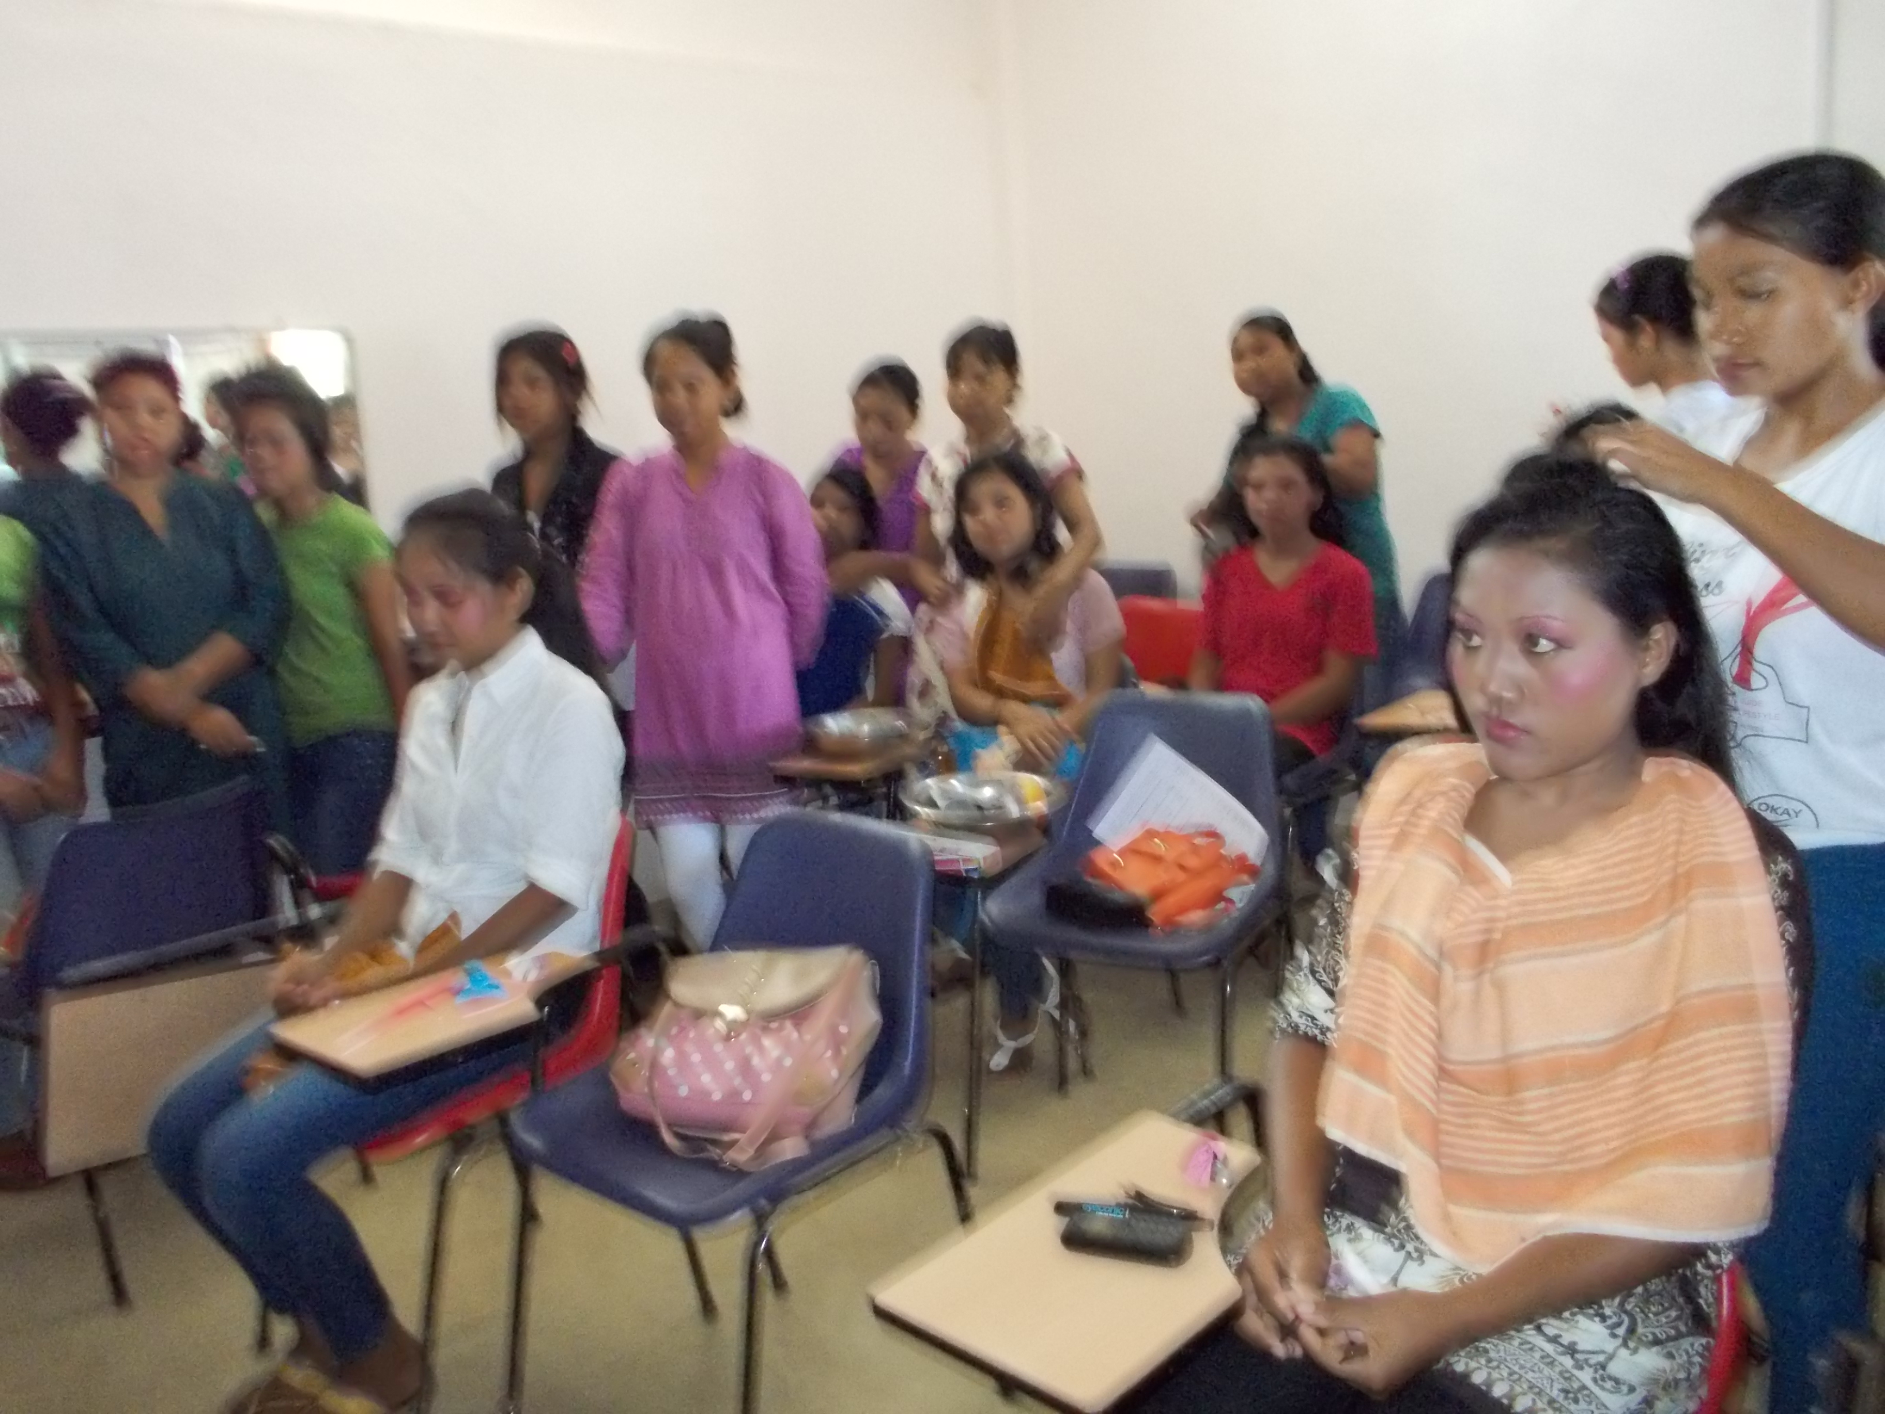
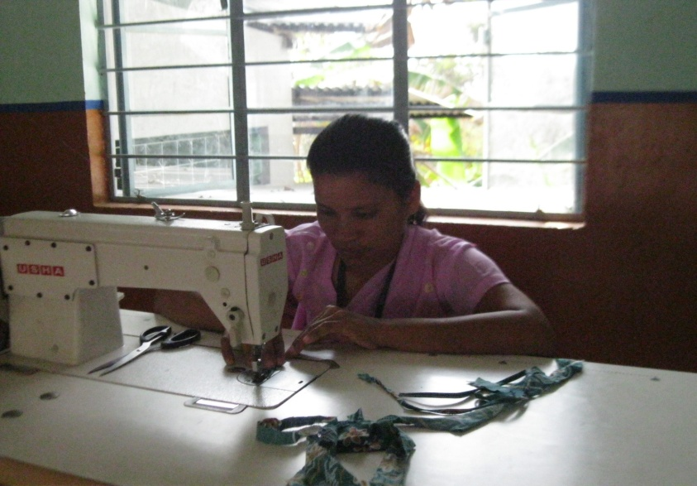
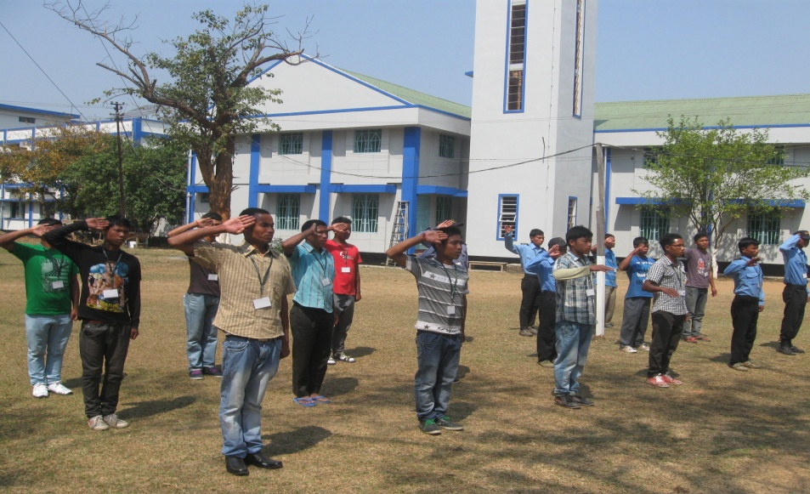
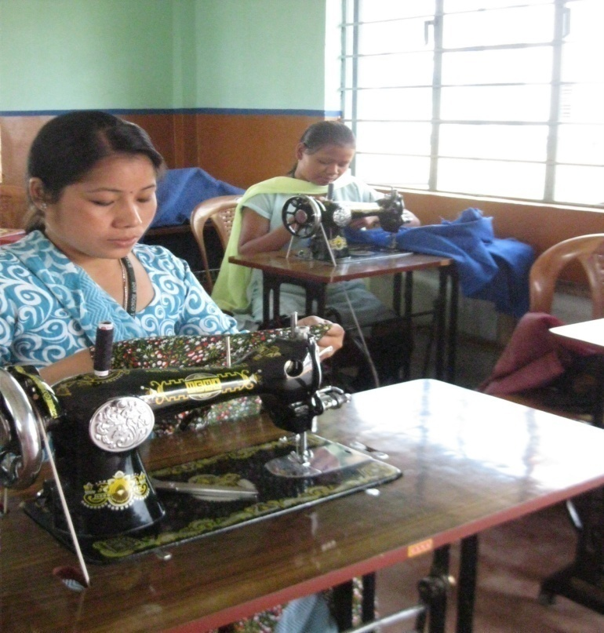
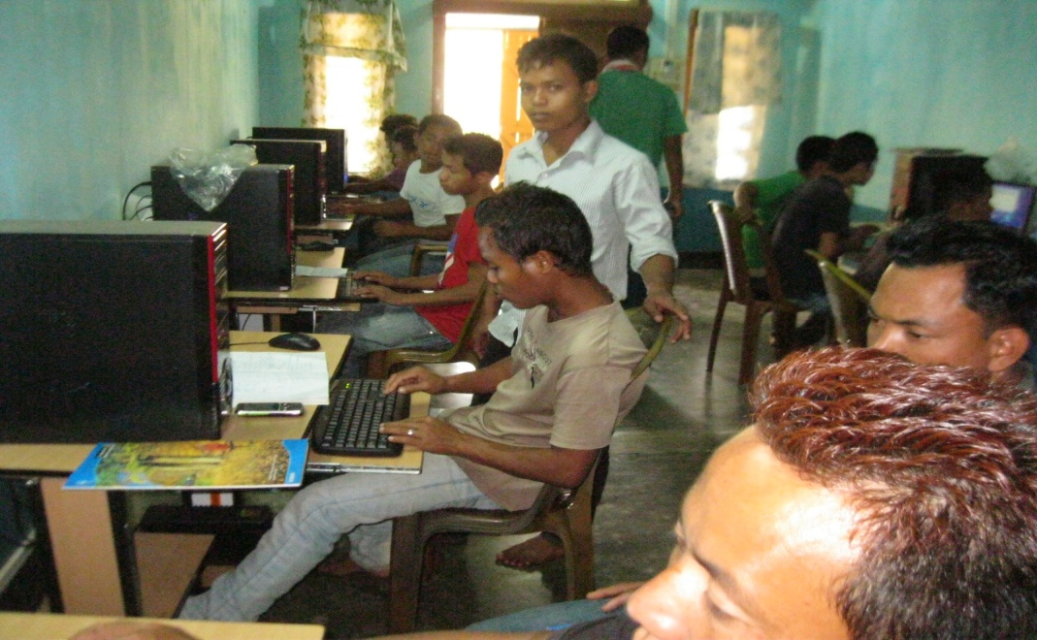
Skill Trainings- A Perspective
Many Training Providers
Varied trades
Numerous schemes
Different approaches
Diverse curriculums
Varying competencies
Notes:
Unstructured, evolving universe

Slide 4
Skill Trainings - The Current Scenario
Key Issues:
Mobilization - youth/ parents lack awareness of the need and availability of training schemes
Opportunity to place students within the state low
Inadequate Infrastructure for training
Competent faculty not easily available within the state
Financial/fund problems
Academics:
Academics not standardized & outcome based
Instructional uniformity : Absence of standardized curriculum, courseware, entry gating criteria etc, so the learning is not uniform
Learning Evaluation: Structured formative & summative assessments not seen to be followed across
Infrastructure: Classroom & Lab facilities not adequate
Faculty competence and instructional skills vary widely
Credibility of certifications & lack of provisions for horizontal and vertical movement
Notes:
Courseware: Instructional uniformity: Text books not always available – the students have to rely on class notes
The competency of the student is not always mapped to the expected learning outcomes of the course.

Slide 5
Bridging the Gap…
SCF
Notes:
Cover our journey from a unevolved universe to an evolving and evolved universe

Slide 6
SCF - An Overview
The Skills Challenge Fund (SCF) has been established to enable demand linked skill building in the state.
Through SCF, MSSDS targets to provide vocational training to 60,000 youth
by engaging with (private and public) training agencies in chosen sectors.
Program will be implemented across all 11 districts.
Quality and timelines will be monitored and evaluated by MSSDS

Slide 7
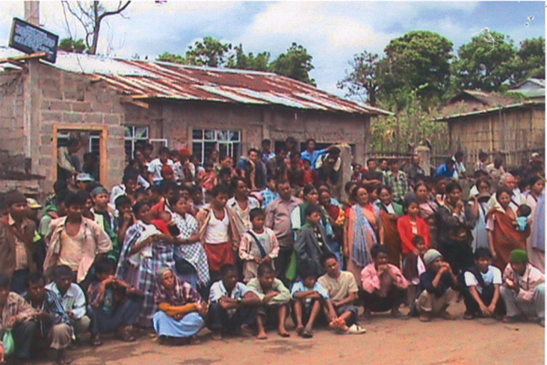
SCF - An Overview
Key Objectives:
Support training for different segments: Rural and urban youth, girls and boys, dropouts (at various levels) and school graduates, Youth seeking employment within and outside Meghalaya.
Arrest migration of potential entrepreneurs by incentivizing them to start enterprises in the state,
Enhance opportunities for wage employment to local people
Accelerate economic progress in the state by providing skilled manpower
Enhance the Employability of the Youth of Meghalaya
The Fund- USD 20.3 million

Slide 8
Eligible Entities to Participate in the Bidding Process
Skill Training Approach Under SCF
Training providers and NGOs that have implemented or are currently implementing skills training on behalf of central , state ministries, or NSDC
Public training providers – ITIs & Polytechnics
Private training organizations & NGOs that have :
training experience in the identified industry sectors
curriculum and training process accredited by NCVT /SSCs / industry associations
Local NGOs & TPs that are:
based in Meghalaya and other north-eastern states
have significant experience of providing skills training and livelihood development support in this region will be encouraged.

Slide 9
Support Provided to the TPs by State
Skill Training Approach Under SCF
Full cost of delivering skills training including:
Training fee for learners & allowances
Salaries of teachers/trainers and support staff ,
One time cost of training and assessment of trainers (by SSCs)
Training materials, consumables & c/w costs
Travel and accommodation directly related to training
Assessment and Certification costs of trainees
Support for mobilizing trainees across districts
District level support from District Project Co-ordination Units (DPCUs)

Slide 10
Support Provided to the TPs by State
Skill Training Approach Under SCF
Full cost of delivering skills training including:
Operating expenses: rental of equipment & training venues,
Placement expenses & Post placement support:
Incentives for training a differently abled trainee
Special Support Areas
Mobilization trainees across districts
Trainees placed outside the state
District level support from DPCUs
Notes:
Inflationary adjustments to the training cost;
Covering margins of profit for the Training Provider.

Slide 11
Skill Training Approach Under SCF
Responsibilities of TPs in Skill Training under SCF
Provide free training to selected youth
Counseling support at all stages
Strong placement services & industry tie ups
Quality Assurance of trainings
Academics
Curriculum aligned to NSQF/NOS
Life Skills integration: Inclusion of Communication & personality development in built
Instructionally sound learning resources – Text & Digital components
Competent faculty with sectorial knowledge - Certified by SSCs
Robust Assessment system focused on LO s - Final assessment through SSc’s
Access to Trade labs & equipment as specified in the curriculum

Slide 12
Thank You

